Slide 1
WEEK 22
Trained ball-grasp policy for the BrainCo Revo 2 hand
Cesar A. Pascal Vasquez
Week 22 | 1
Notes:
[Sources]
- /Users/cesarpascal/Desktop/BrainCo Revo2 MuJoCo/README.md
[/Sources]

Slide 2
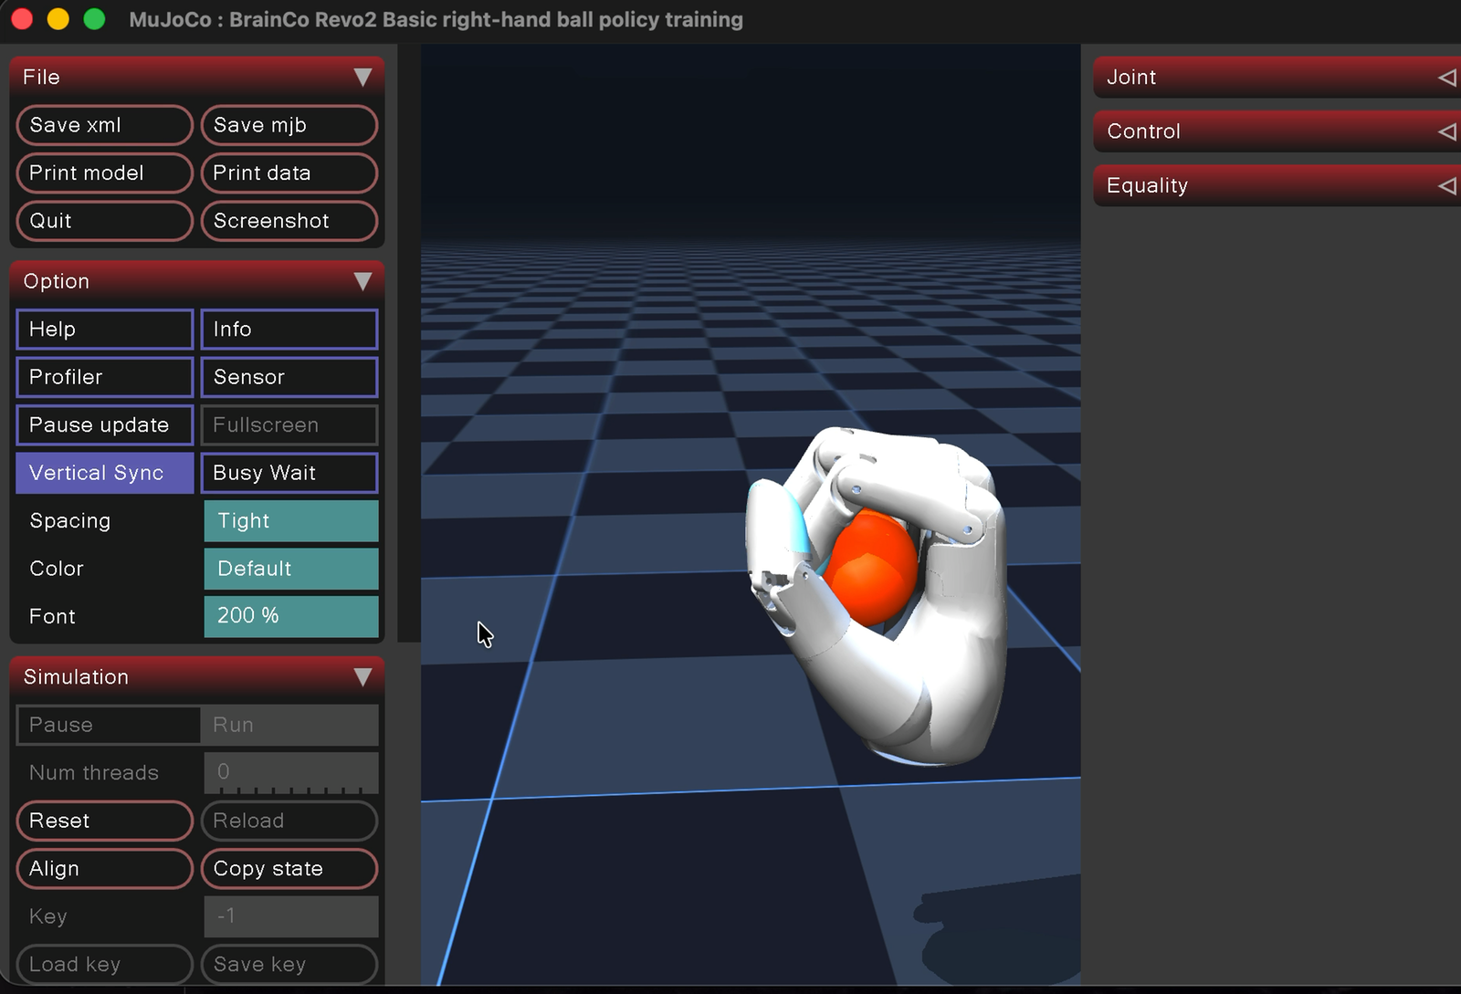
The trained policy holds a free ball under gravity.
The controller closes the six active hand commands, watches the simulated ball state, and corrects the grasp during each episode.
The same setup also supports a small in-hand movement policy while the wrist remains fixed.
Orange: grasped ball
Week 22 | 2
Notes:
[Sources]
- /Users/cesarpascal/Desktop/Screen Recording 2026-07-25 at 4.01.20 PM.mov
- /Users/cesarpascal/Desktop/BrainCo Revo2 MuJoCo/policies/revo2_right_hold.json
- /Users/cesarpascal/Desktop/BrainCo Revo2 MuJoCo/policies/revo2_right_move.json
[/Sources]

Slide 3
The policy converts 19 state features into six hand commands.
INPUT
OUTPUT
Ball-to-target error
Ball linear and angular velocity
Six normalized joint positions
Gravity fraction
Thumb opposition
Thumb flexion
Index, middle, ring,
and pinky flexion
CLOSED-LOOP POLICY
120 trained parameters
50 Hz command rate
STATE → LINEAR FEEDBACK → SIX COMMANDS
Week 22 | 3
Notes:
[Sources]
- /Users/cesarpascal/Desktop/BrainCo Revo2 MuJoCo/scripts/revo2_grasp_env.py
- /Users/cesarpascal/Desktop/BrainCo Revo2 MuJoCo/scripts/train_grasp_policy.py
[/Sources]

Slide 4
Training uses repeated MuJoCo rollouts.
1
Randomize the ball position at reset.
2
Close the hand first with zero gravity.
3
Ramp to 9.81 m/s² and apply an external force.
4
Reward low error, multiple contacts, smoothness, and survival.
Optimizer: Cross-Entropy Method (CEM). The saved controller is a compact linear feedback policy, not a deep neural network.
Week 22 | 4
Notes:
[Sources]
- /Users/cesarpascal/Desktop/BrainCo Revo2 MuJoCo/scripts/revo2_grasp_env.py
- /Users/cesarpascal/Desktop/BrainCo Revo2 MuJoCo/scripts/train_grasp_policy.py
[/Sources]

Slide 5
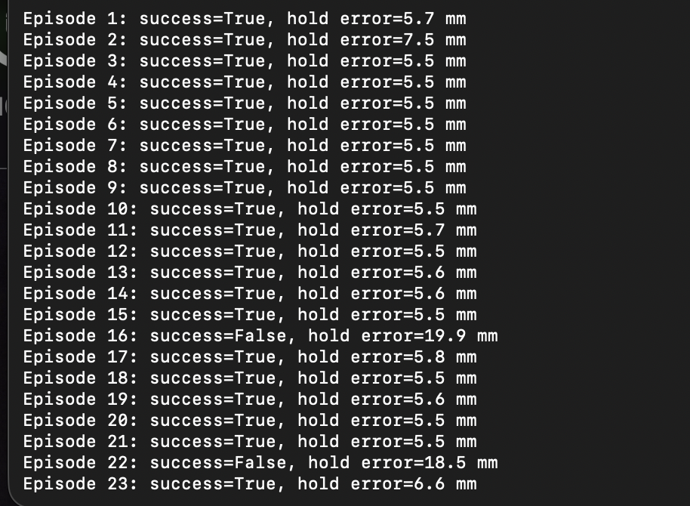
The recorded run succeeded in 21 of 23 episodes.
91%
success rate
5.7 mm
mean error on successful episodes
Two misses: 19.9 mm and 18.5 mm
Week 22 | 5
Notes:
[Sources]
- /Users/cesarpascal/Desktop/Screenshot 2026-07-25 at 4.04.00 PM.png
- Metrics calculated directly from the supplied screenshot: 21/23 = 91.3%; successful-episode mean = 5.7 mm.
[/Sources]

Slide 6
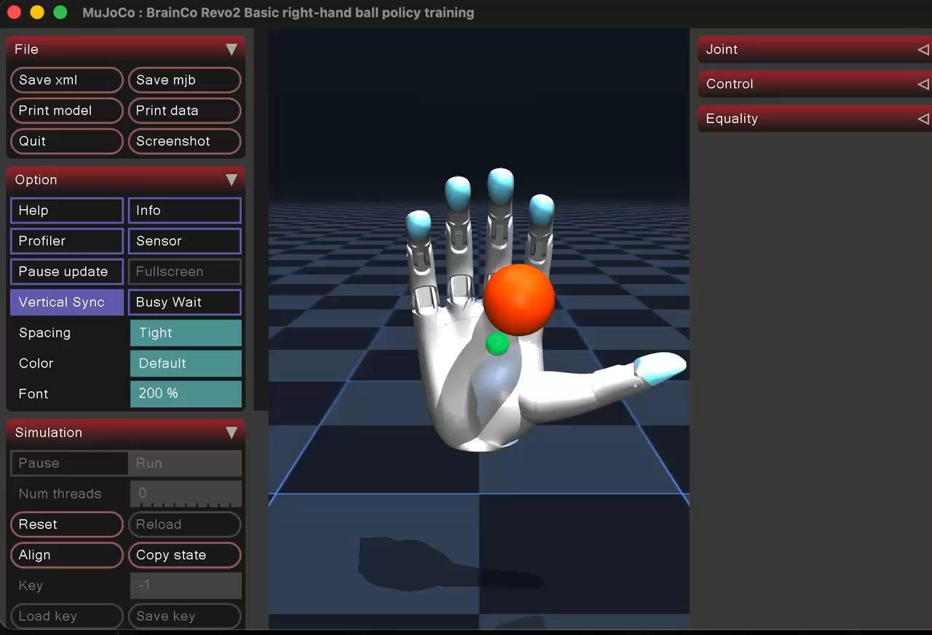
The trained hand retains the ball under gravity.
Embedded recording — click the video during Slide Show mode.
Week 22 | 6
Notes:
[Sources]
- /Users/cesarpascal/Desktop/Screen Recording 2026-07-25 at 4.01.20 PM.mov
[/Sources]

Slide 7
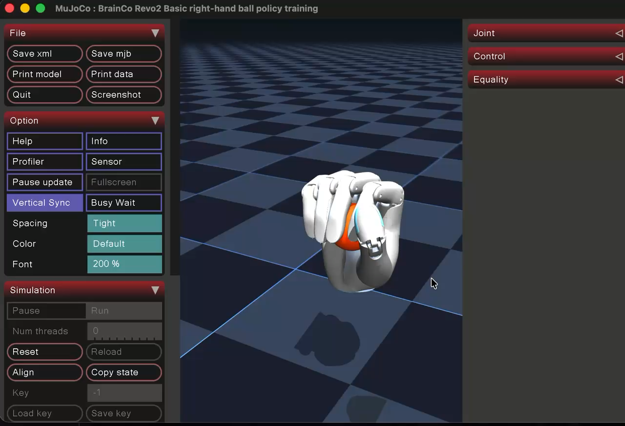
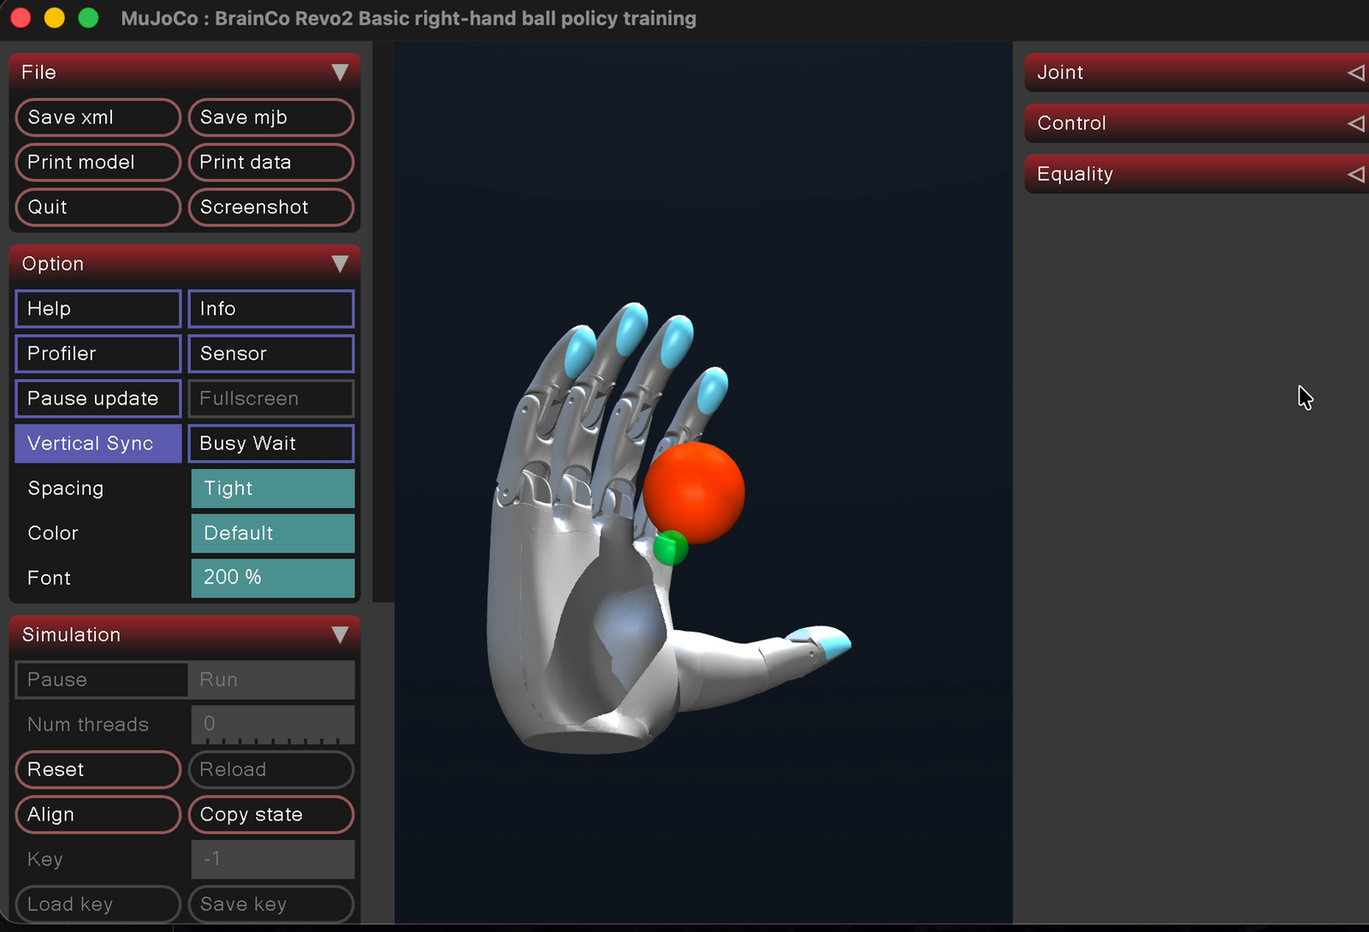
The movement policy shifts the ball in-hand.
Green: target | measured in-hand ball range ≈ 2.2 mm
Week 22 | 7
Notes:
[Sources]
- /Users/cesarpascal/Desktop/Screen Recording 2026-07-25 at 4.04.36 PM.mov
- /Users/cesarpascal/Desktop/BrainCo Revo2 MuJoCo/policies/revo2_right_move.json
[/Sources]

Slide 8
Next: connect the hand policy to the R1 wrist and arm.
• Move the ball through space with coordinated arm and finger control.
• Expand training with more object positions, forces, and grasp tasks.
• Validate command limits, latency, and safety on the physical robot.
The current result is a verified fixed-wrist hand controller and a practical starting point for whole-arm manipulation.
Week 22 | 8
Notes:
[Sources]
- /Users/cesarpascal/Desktop/BrainCo Revo2 MuJoCo/README.md
- /Users/cesarpascal/Desktop/BrainCo Revo2 MuJoCo/policies/revo2_right_hold.json
- /Users/cesarpascal/Desktop/BrainCo Revo2 MuJoCo/policies/revo2_right_move.json
[/Sources]

